Slide 1
NutritionExpert
Group A
Dana Lee, Dustin Tsai, Sunny Chin, Ting-Yu Lin
Mentor: Eric Young

Slide 2
Table of contents
Introduction
01
04
Results & Discussion
Dataset &
Data Preprocessing
02
05
Conclusion
Methodology
03
06
Future work

Slide 3

01
Introduction

Slide 4
Introduction
Why:
How:
Many individuals struggle with estimating calories, analyzing nutrition, and planning balanced meals while fitting their personal preferences and goals.
UECFOOD-256 dataset
School Lunch dataset
1. Meal Analysis：YOLOv8 model CalorieNinjas API
2. Diet Planning： GPT-4 model
Streamlit

Slide 5
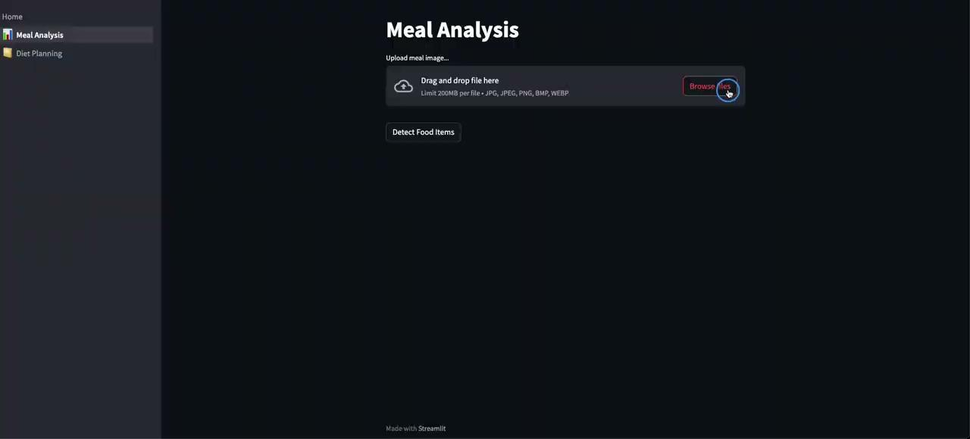
Meal Analysis

Slide 6
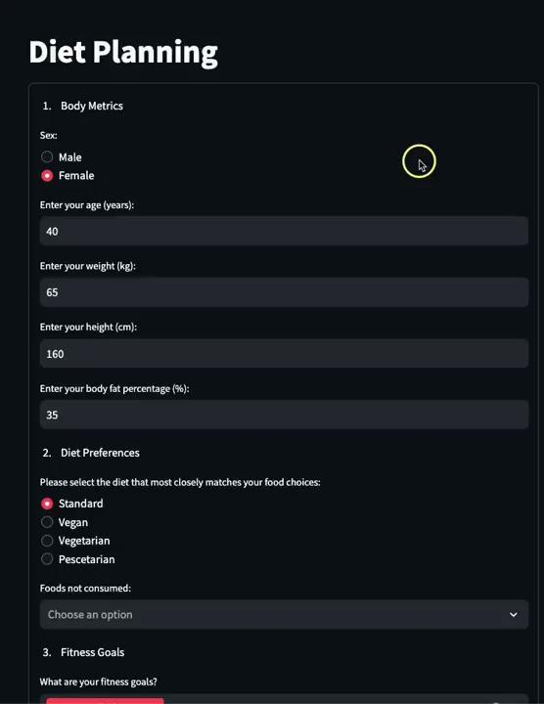
Diet Planning

Slide 7
Key Milestones
Dataset
Data Preprocessing
Model
Training
API Integration

Slide 8
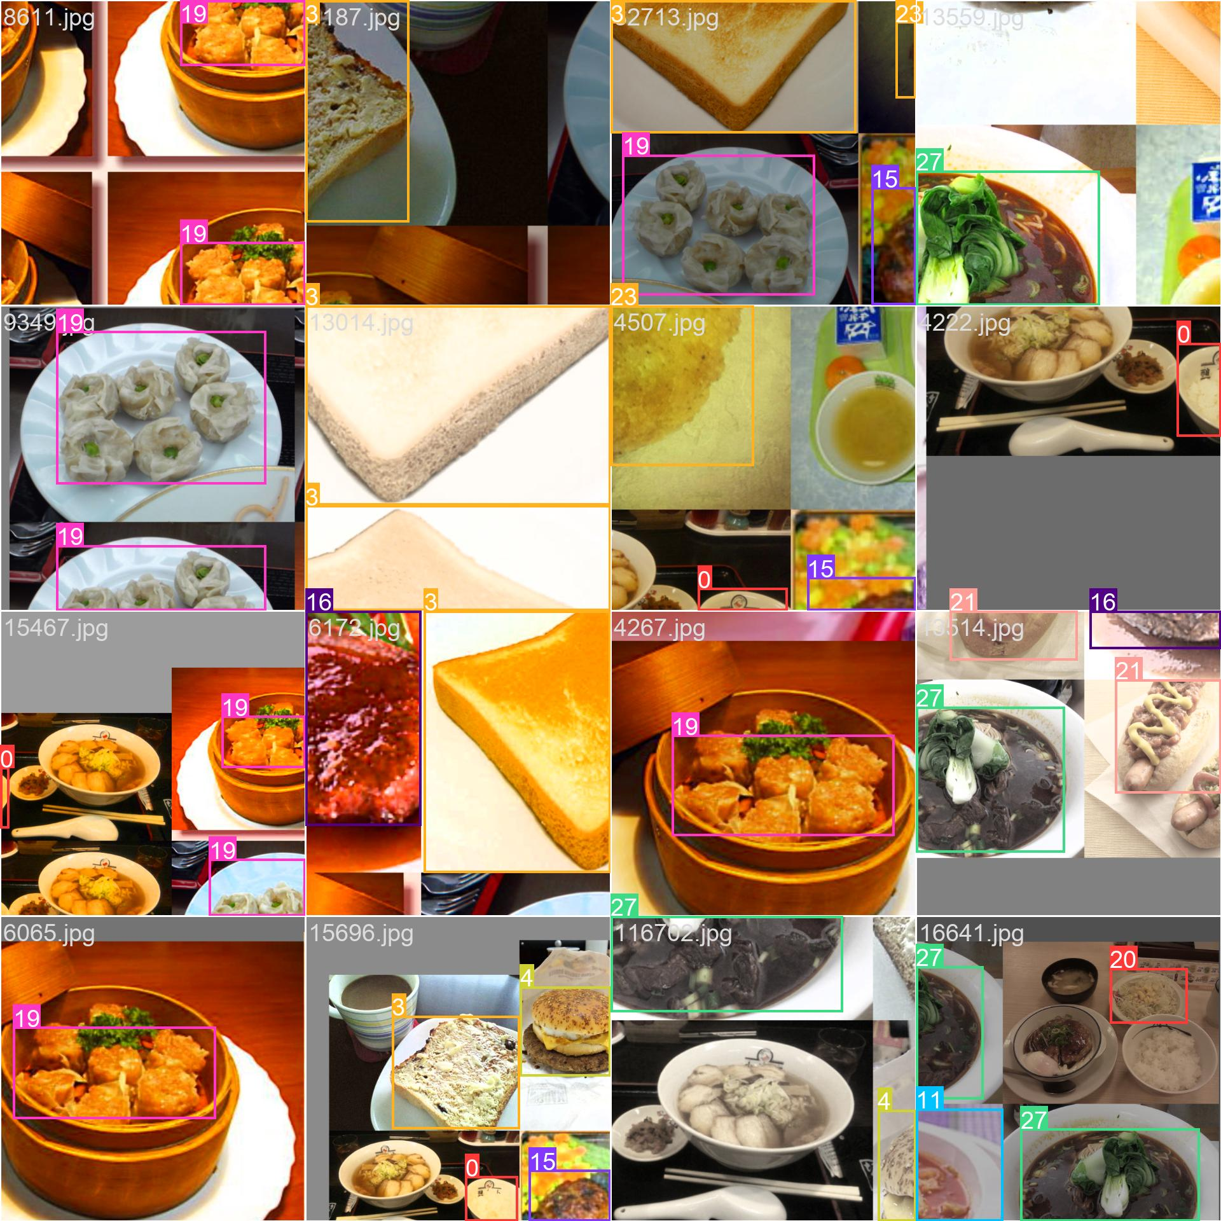
02
Dataset &
Data Preprocessing

Slide 9
UECFOOD-256＋School lunch http://foodcam.mobi/dataset.html
Dataset Selection
Data Cleaning
Data Transformation
Dataset Splitting
Each food photo has an annotation with
bounding box information.
"UEC FOOD 256" contains 256 kinds of food items.
Most of the food categories are Japanese/Asian style.
Rename to avoid overwriting if file name has existed.
Data normalization
Train : Val = 9 : 1
Notes:
CVAT

Slide 10
Data Preprocessing
276 categories
65 categories

Slide 11
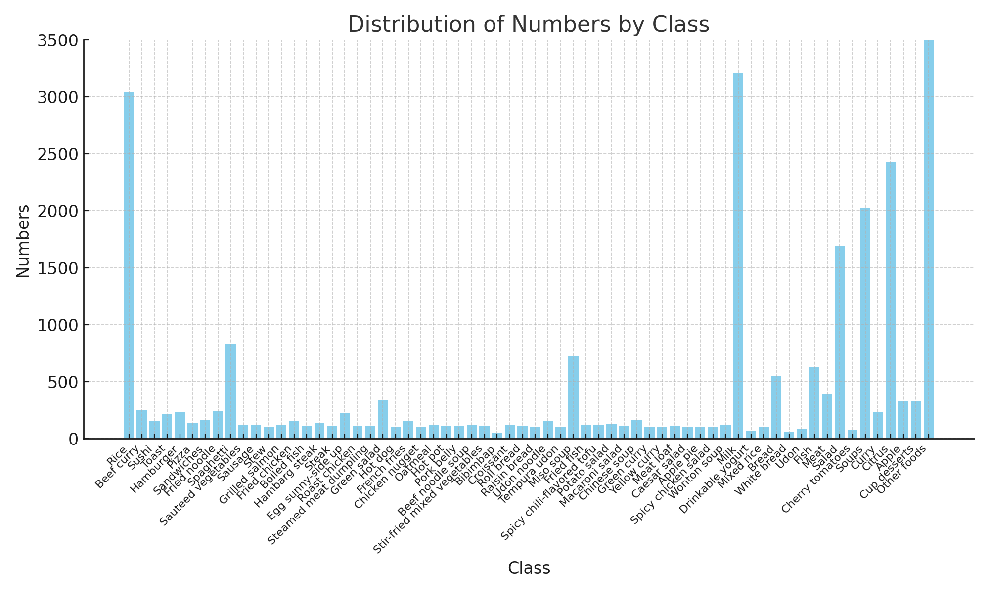
Number of images per class

Slide 12
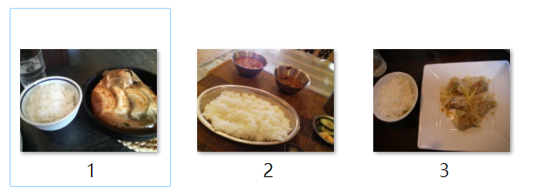
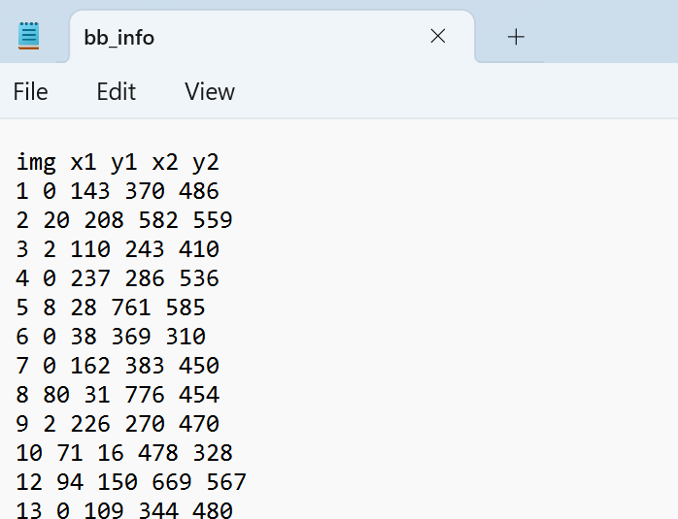
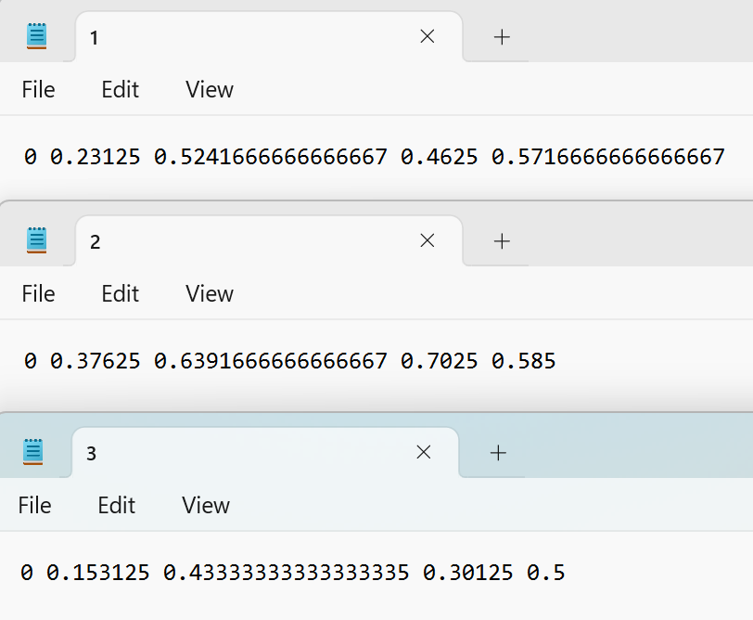
Each image corresponds to one txt file
1
2
3

Slide 13
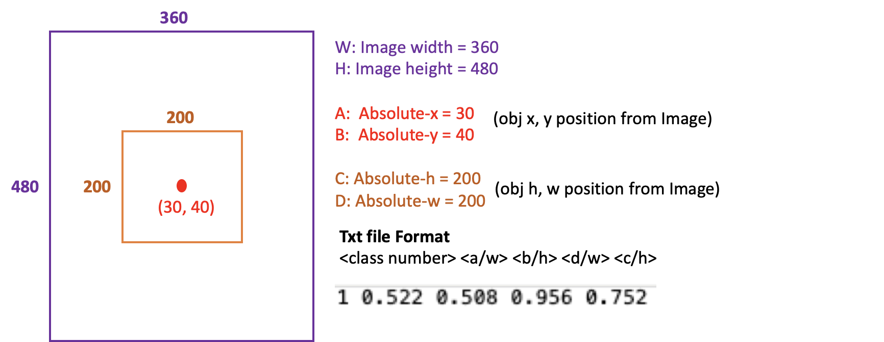
Annotation - YOLO Labeling Format

Slide 14
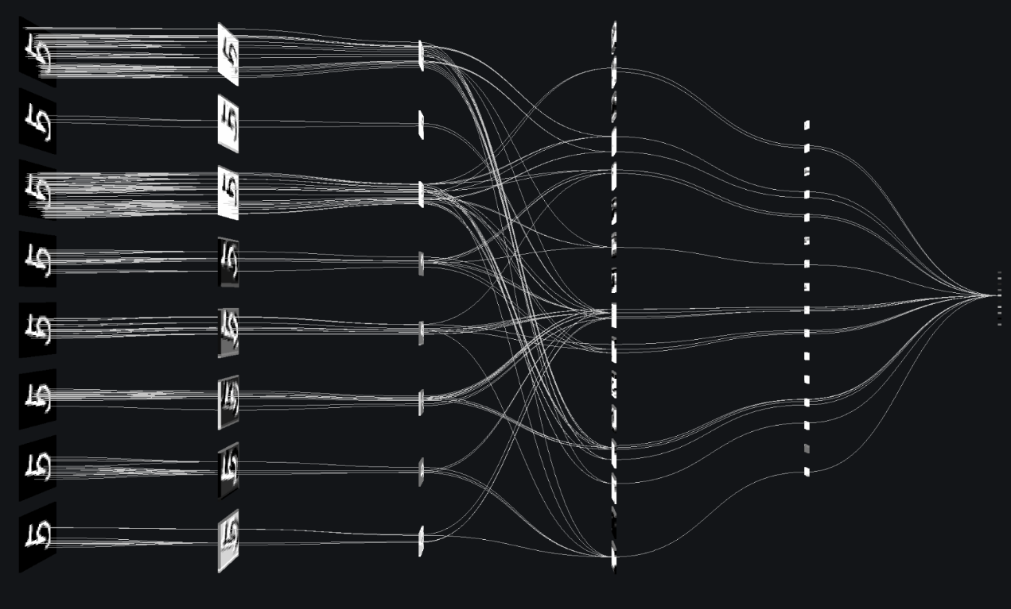
03
Methodology

Slide 15
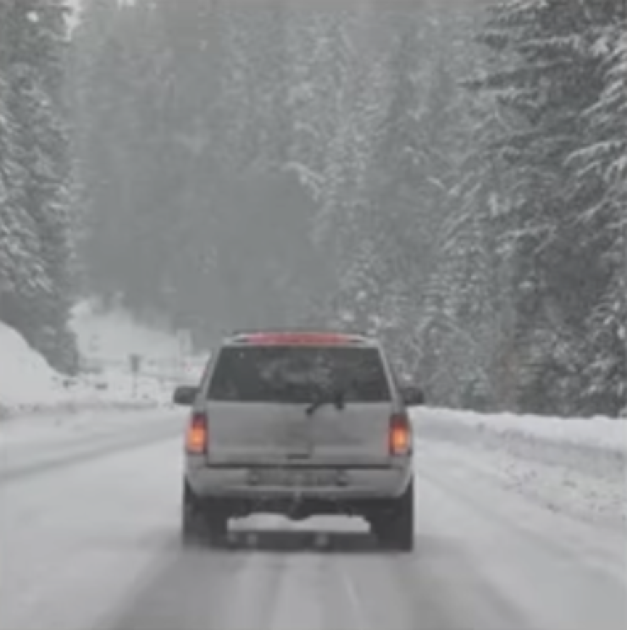
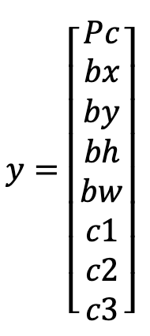
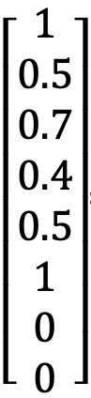

YOLOv8- Algorithm
Input Parameters
標籤資訊
目標物中心點 信心度
Bounding Box X座標
Bounding Box Y座標
Bounding Box 高
Bounding Box 寬
Class 1 機率
Class 2 機率
Class 3 機率
1
car
0.7
c1假設為汽車、c2是人、c3是巴士
0.5

Slide 16
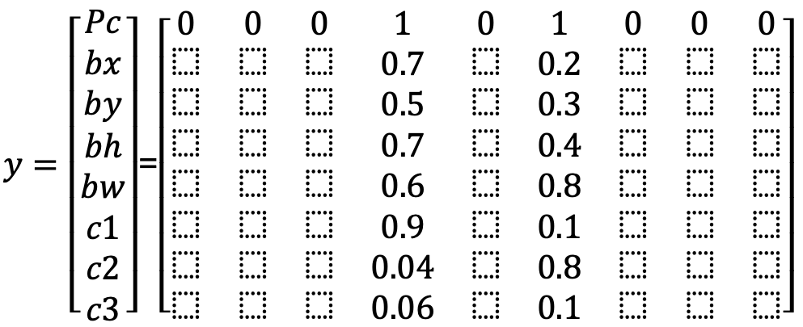
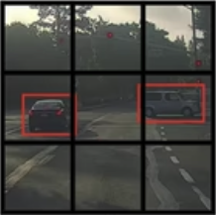
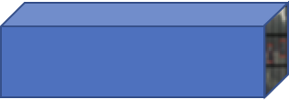
YOLOv8- Algorithm
Image and Label Processing
Parameters for each grid => 1 x 1 x 8
Usually in 19*19
(361 boxes)
Parameters for whole picture => 3 x 3 x 8
Notes:
人工標註(true label)

Slide 17
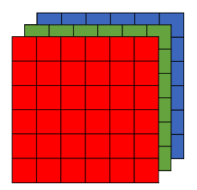
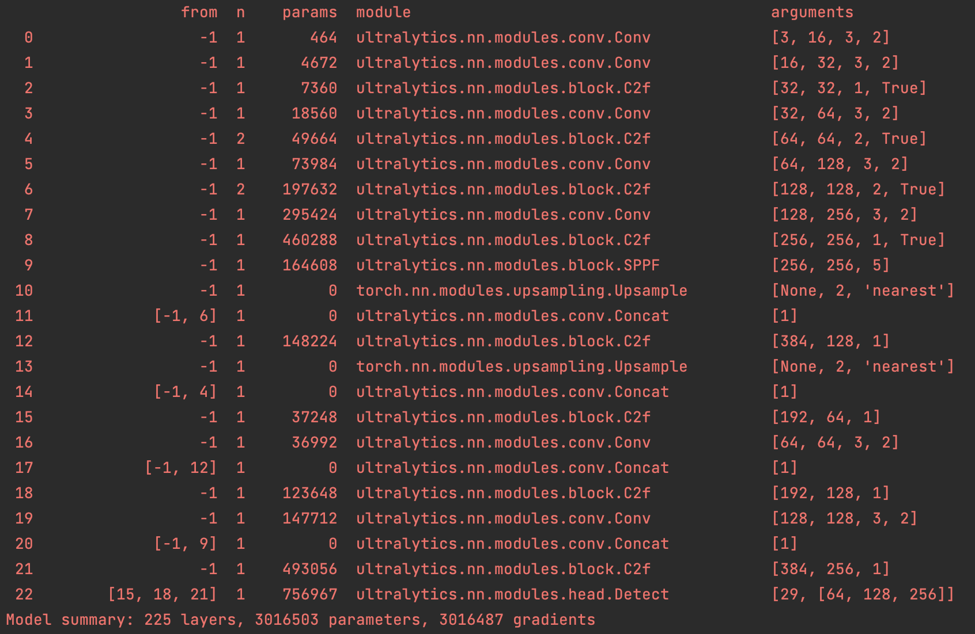
YOLOv8- Algorithm
Training Process
Original Image
3 x 3 x 8
100 x 100 x 3
best.pt

Slide 18
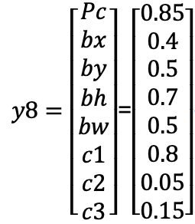
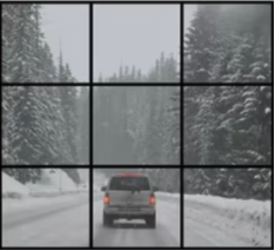
YOLOv8- Algorithm
Testing Process-1
best.pt
NOTE 1. | NOTE 2.
bx, by : must < 1 bh, bw : may > 1 | Pc is not likely to be 0 (especially where it's indistinguishable)
Notes:
如果現在是一個超出該box的卡車、校車

Slide 19
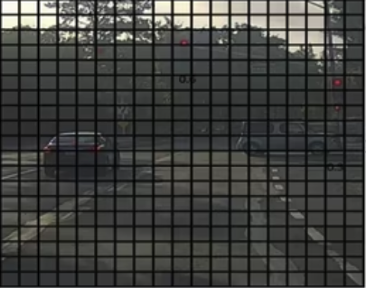
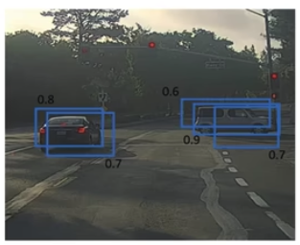
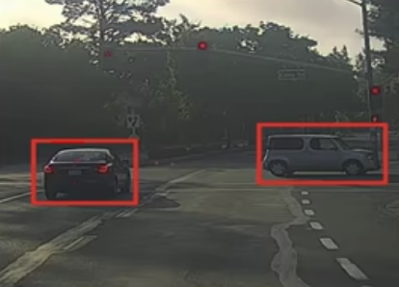
Testing Process-2 IoU (Intersection over Union)
Testing Process-3 NMS (Non-Maximum Suppression)
IoU >= 0.5
Area of Overlap
Area of Union
0.8
car
0.9
car
Notes:
交併集 交集X / 聯集Y 得到
非極大值抑制
Only give parameters whose Pc > 0.4
Do NMS

Slide 20
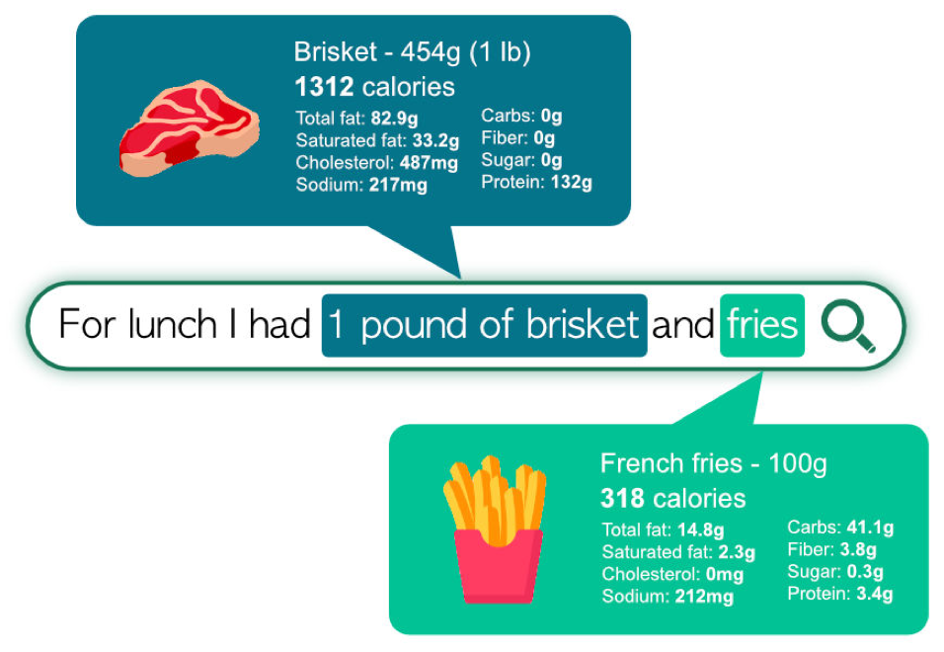
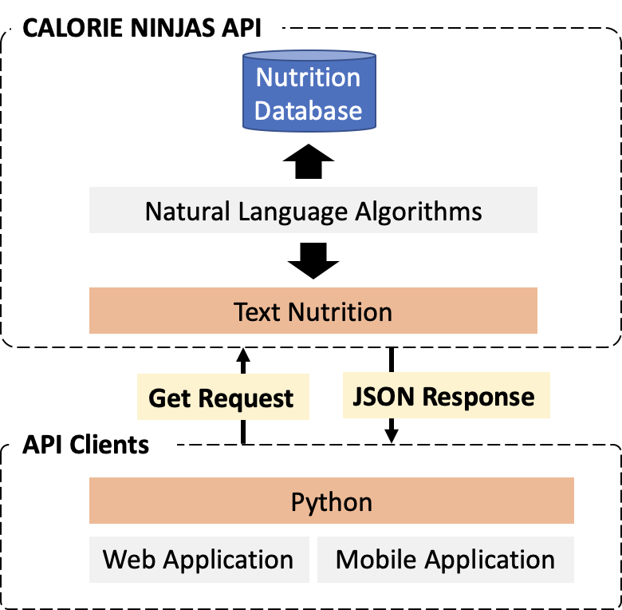


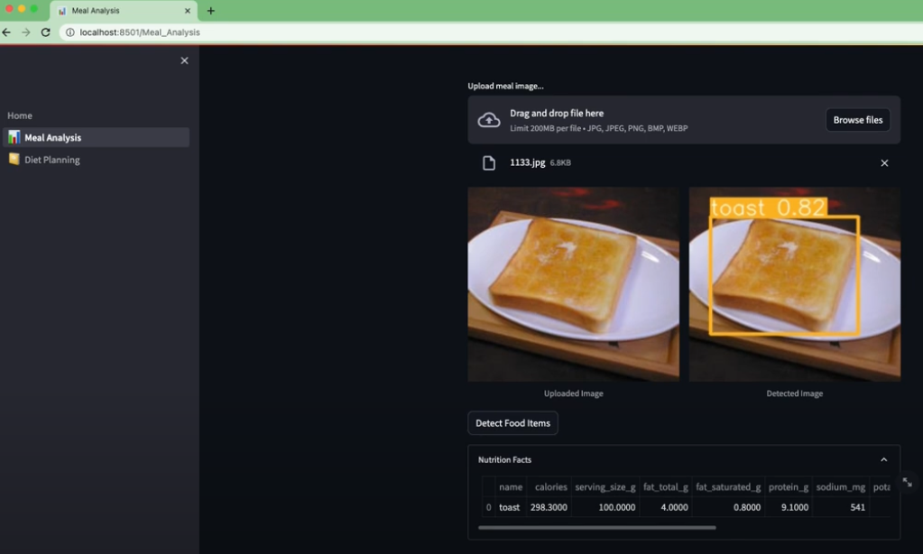
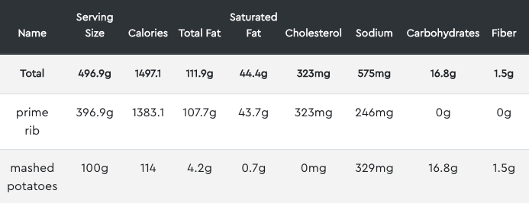
CALORIE NINJAS / STREAMLIT
Calorie Ninjas Framework

Slide 21
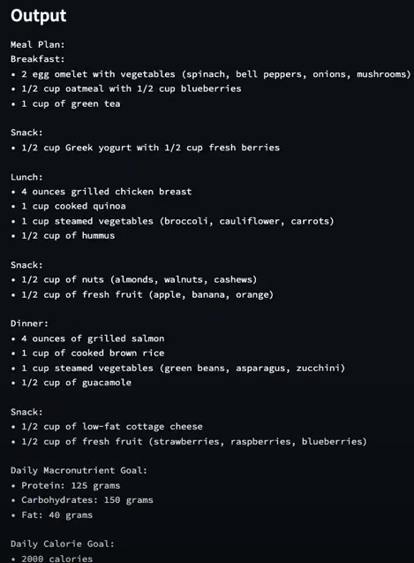
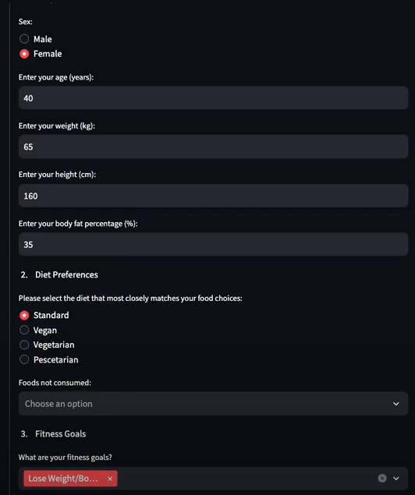
GPT-4 (Open AI API)
Interface

Slide 22

04
Results & Discussion

Slide 23
LOSS & PRECISION_definition
box_loss: bounding box
dfl_loss: class imbalance issue
cls_loss: food classification
Precision (P) = # of True positives / total positives
Recall (R) = # of True positives / total cases
If IoU >= 0.5, true positive
mAP: mean average precision (AP: metric to measure the accuracy of object detectors for each class) (m: mean for all classes)
mAP50(B): if confidence score > 0.5, positive detection (Default)
mAP50-95(B): a range of confidence thresholds from 0.5 to 0.95
Notes:
名詞定義
dfl: dual focal loss
cls: classification loss
To point out some problems of 10 epochs with the default hyperparameters
IoU (Intersection over union) = area of intersection between predicted bounding box and ground truth one / area of the union (mAP50 means the IoU = 0.5, 0.5 is the default confidence threshold)
用圖像化的方式解釋名詞

Slide 24
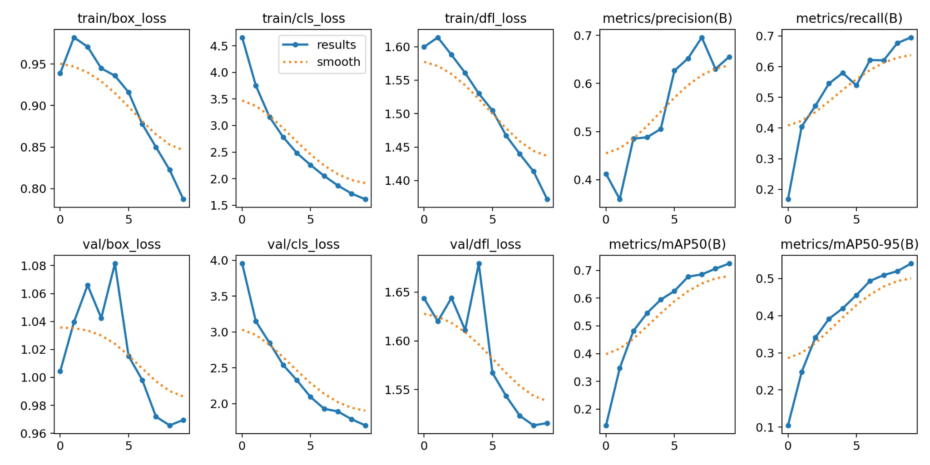
LOSS & PRECISION_results1 (256)
10 epochs / 80% train - 10% val - 10% test / weight decay = 5e-4 (Reference)
Train
Val
Notes:
To point out some problems of 10 epochs with the default hyperparameters
問題：data數太少 (每個 class 的 image數才幾百張，而且每張image也只有一個bounding box，表示僅一個label)

Slide 25
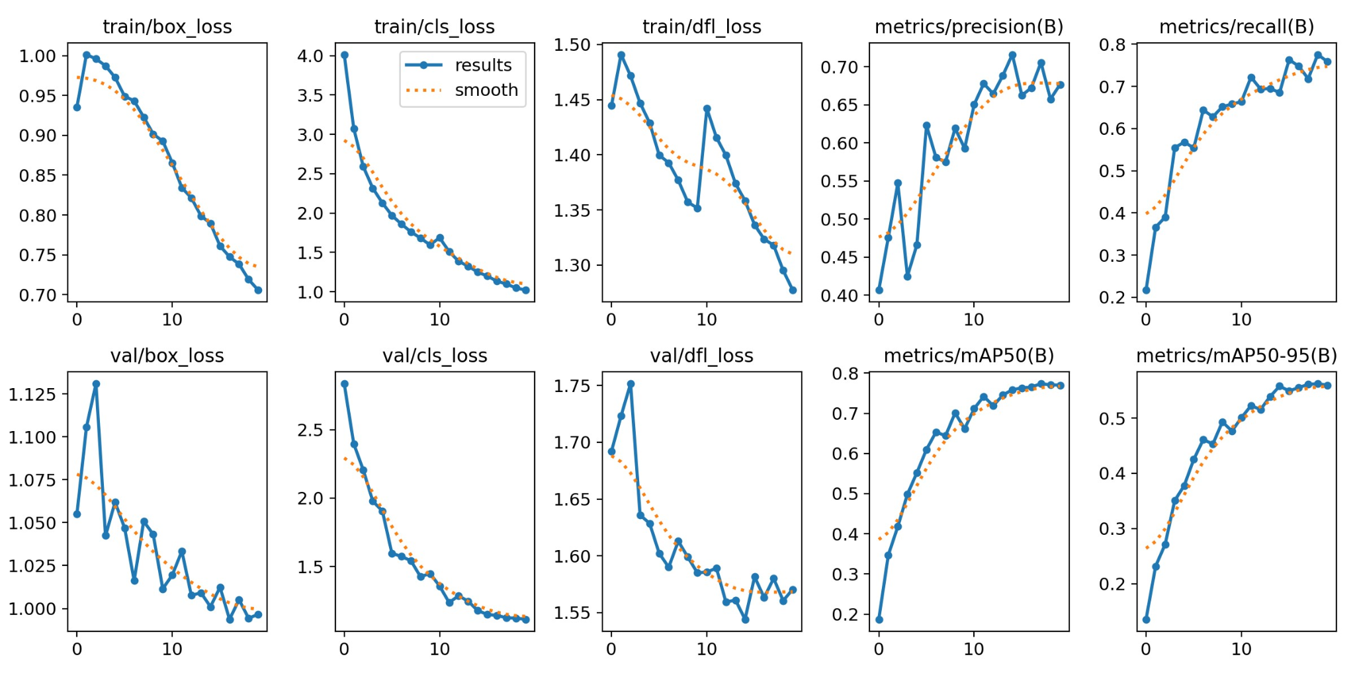
LOSS & PRECISION_results2 (256)
20 epochs / 90% train - 10% val / weight decay = 3e-2
Train
Val
Notes:
Increase number of epochs
Tune weight_decay parameter
Assign dropout probability
增加train的data數

Slide 26
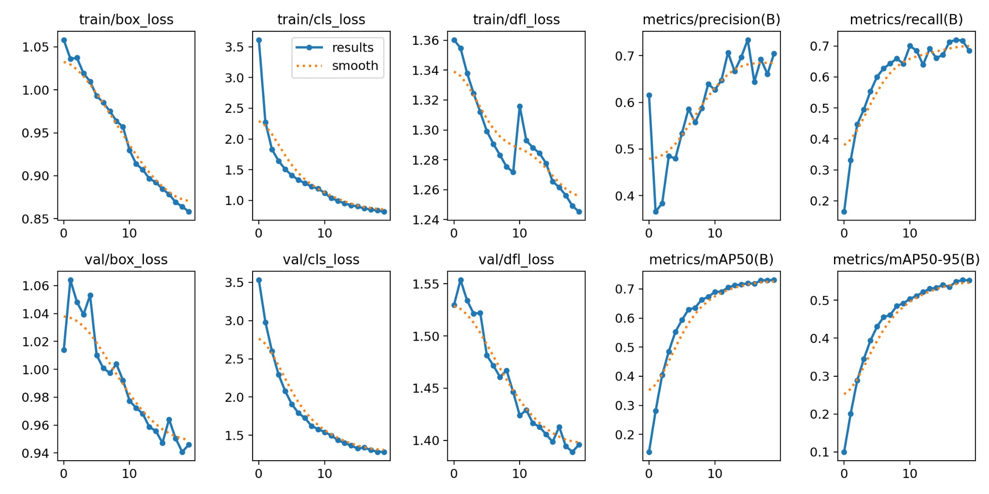
LOSS & PRECISION_results3 (256 + school_lunch)
20 epochs / 90% train - 10% val / weight decay = 3e-2
Train
Val
Notes:
Increase number of epochs
Tune weight_decay parameter
Assign dropout probability
增加train的data數 (More classes in Food256, and include school_lunch datasets)
dfl_loss increases during training (Reason: my model's performance is degrading, not improving)
Instability: Some models or optimization techniques can be unstable, causing fluctuations or increases in the loss. For example, techniques like batch normalization or certain activation functions like ReLU can sometimes cause instability.
Data Issues: If there are issues with the data, like incorrect labels, or if the data is not shuffled and is provided in a certain order during training, it could cause issues with the loss

Slide 27
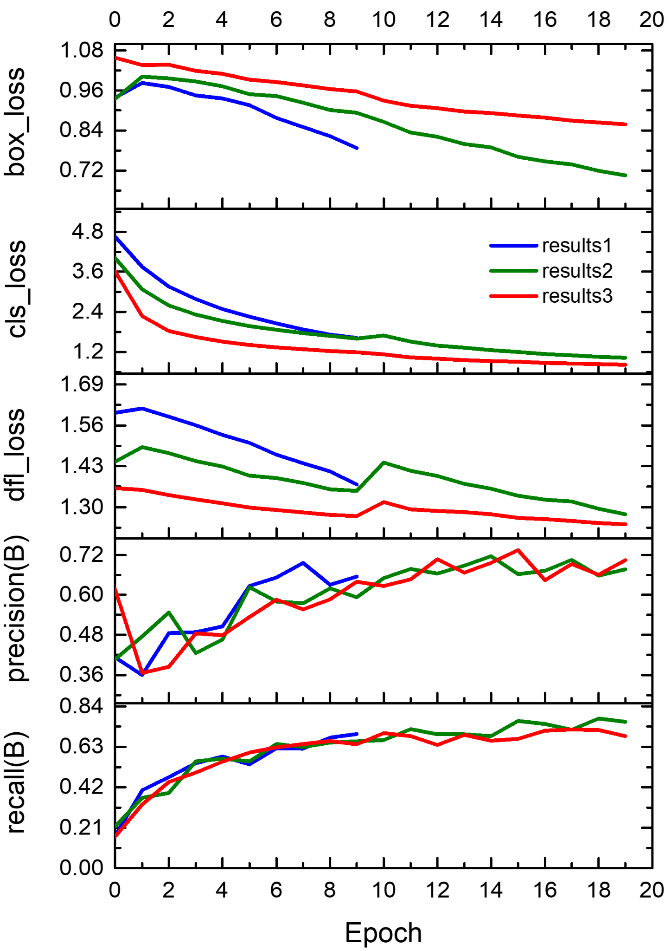
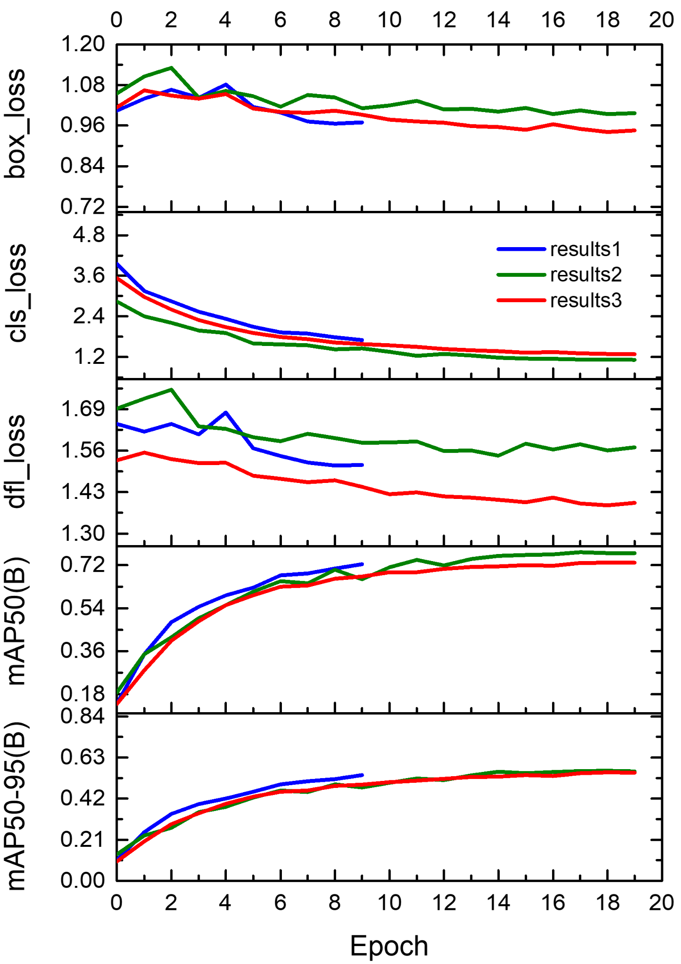
LOSS & PRECISION_comparison
Train
Val

Slide 28
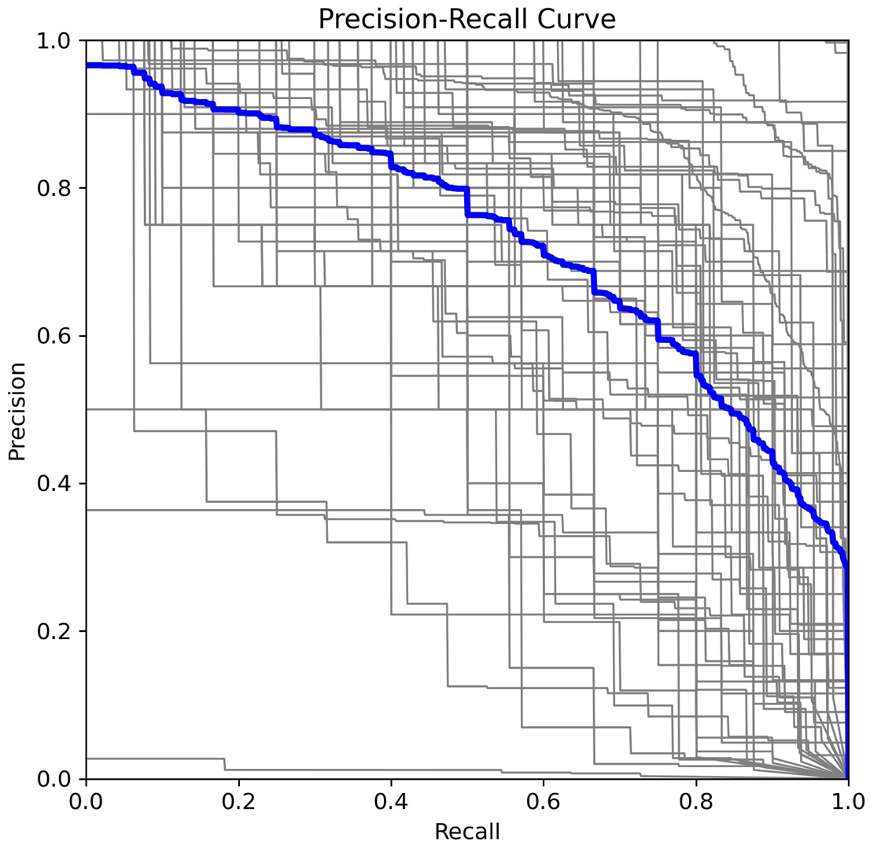
Precision-Recall (P-R) Curve
AP of the selected classes (65 classes) are averaged.
Trade-off between precision and recall across various confidence thresholds.
Each edge stands for one specific threshold
The area under the P-R curve represents mAP value.
All classes
0.73 mAP@0.5
Notes:
Reference
1.https://scikit-learn.org/stable/auto_examples/model_selection/plot_precision_recall.html
黑線表示各個class的 P-R curves (29條)
藍線愈往右上拱起來, mAP愈大

Slide 29
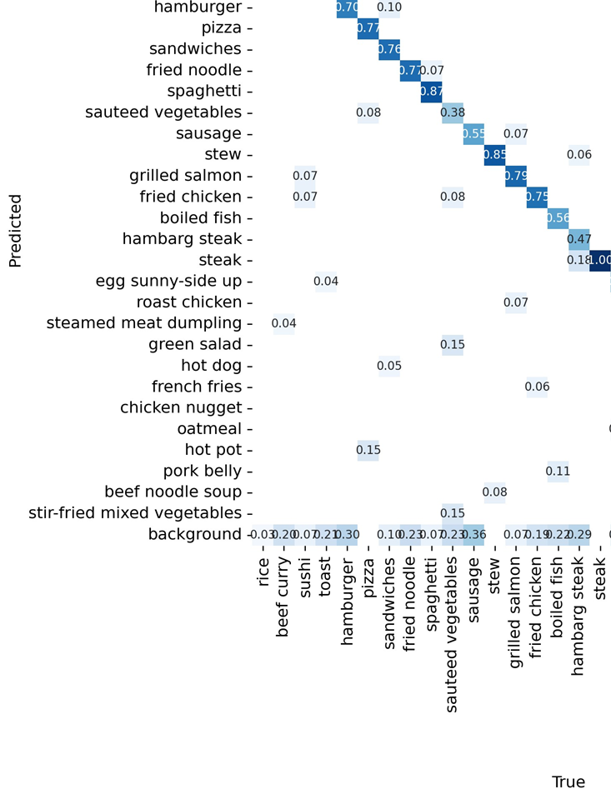
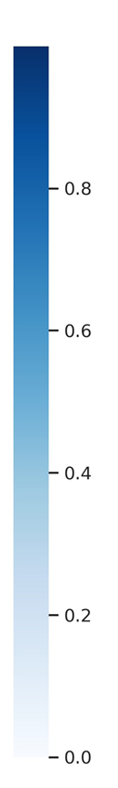
Confusion Matrix (Normalized)
Notes:
可以多針對一些數字(precision)小的case來說明
Sauteed vegetable: 炒蔬菜

Slide 30
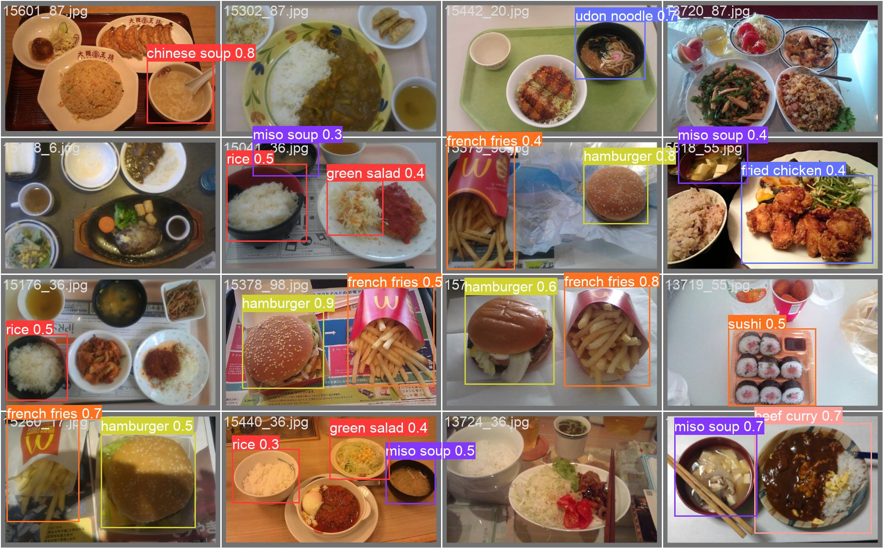
Validation Results_batch1
Notes:
數字表示各自的precision

Slide 31
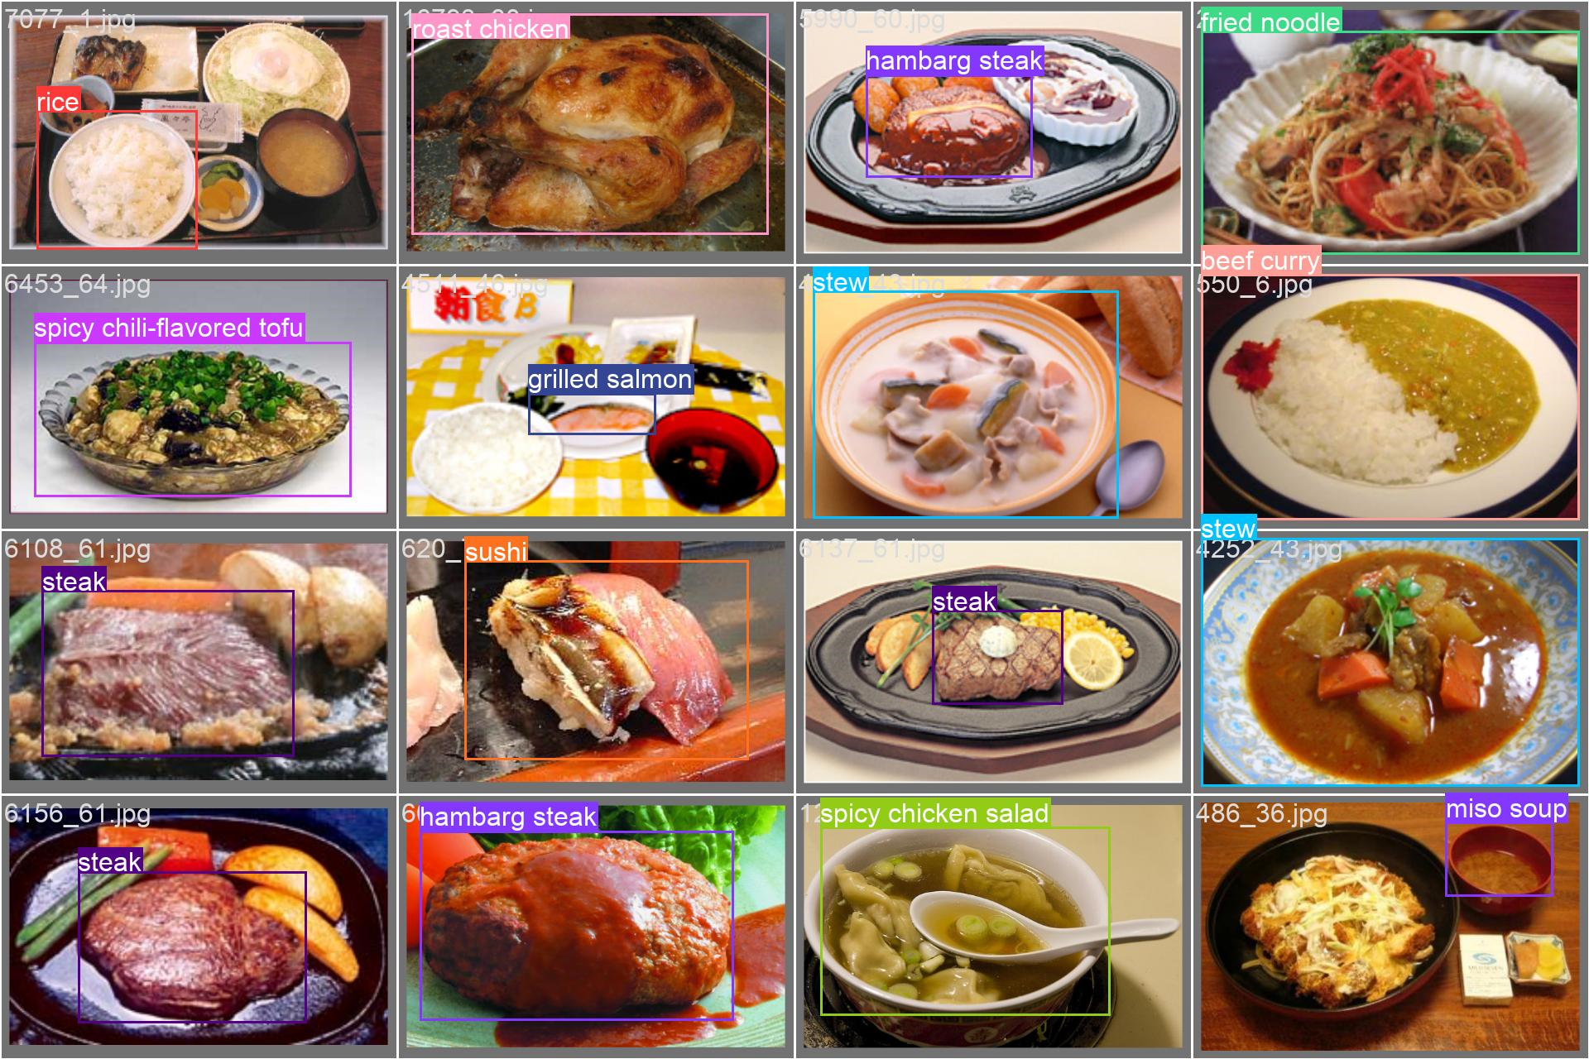
Validation Results_batch2
Notes:
有圖片沒有被框出來，表示該圖片的 confidence 小於 threshold
有一張圖片沒有被bounding box圈選出來，可能是蛋的位置太偏左下且不完整，所以IoU太小並小於threshold

Slide 32
05
Conclusions
&
Future Work
Notes:
做了很多results，選用甚麼hyperparameters
To include more datasets such as school_lucnch
To build up an approach to select classes more accurately, not only from intuition
To avoid the problem of having the same filename for images or labels in different classes

Slide 33
Conclusions & Future Work
1. Increase the number of categories and images
2. Handling imbalanced data
3. Weight measurements
Our optimized model exhibits decent object detection performance (mAP ~73%) across all food classes. Combining our model with the CalorieNinjas and OpenAI (GPT-4) APIs, we were able to develop a reliable personalized AI nutritionist.
It could lead to bias in the model's predictions
People who are not in Japan or Asia may not find our selected food classes relevant
The number of images per class and labels per image can affect model performance
Try some methods to identify the volume and weight of foods in image, and provide more accurate nutrition information
Notes:
1. 判斷食物的大小，再轉換為可能的克數，以準確提供實際營養資訊
2. Image當中對應的bounding box數量可以提升，如同school_lunch datasets
3. Handling imbalanced data

Slide 34

Thanks!

Slide 35
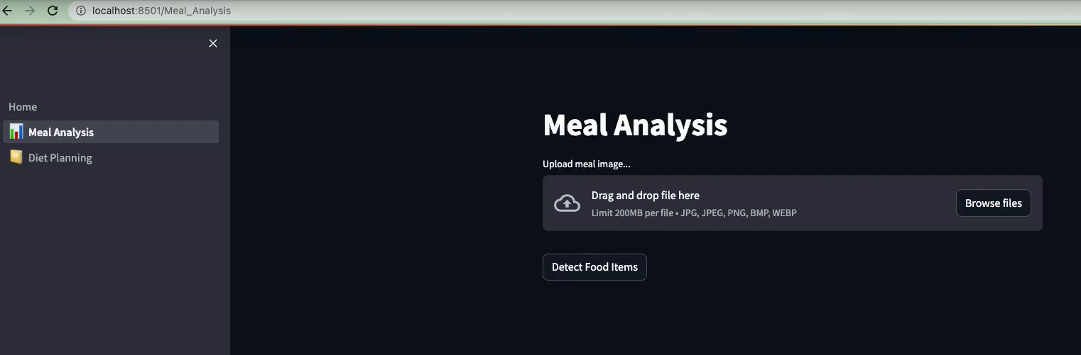
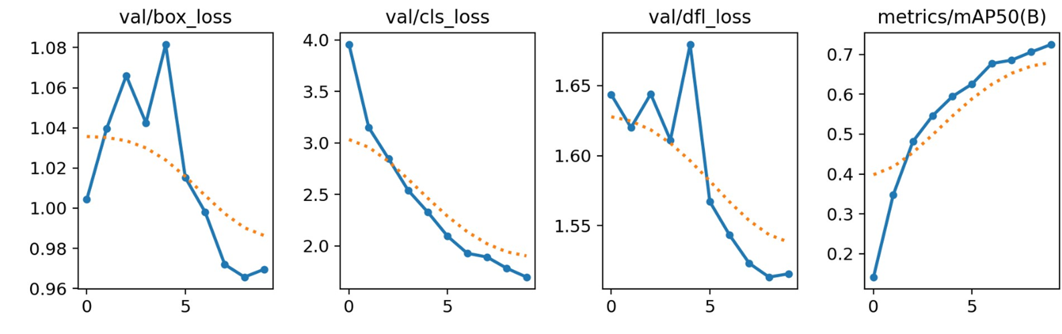
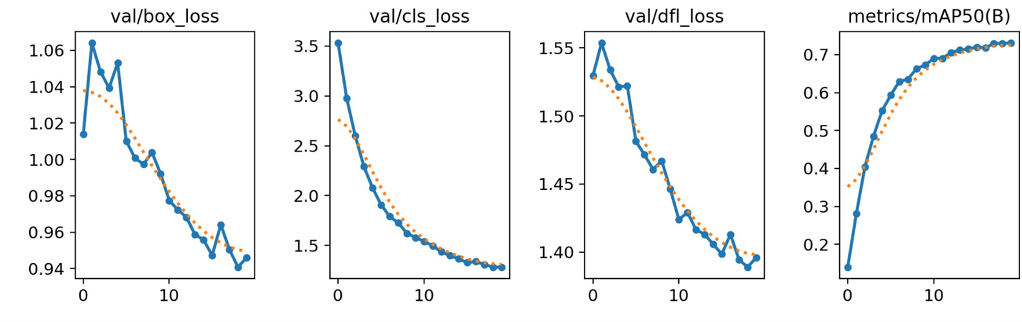
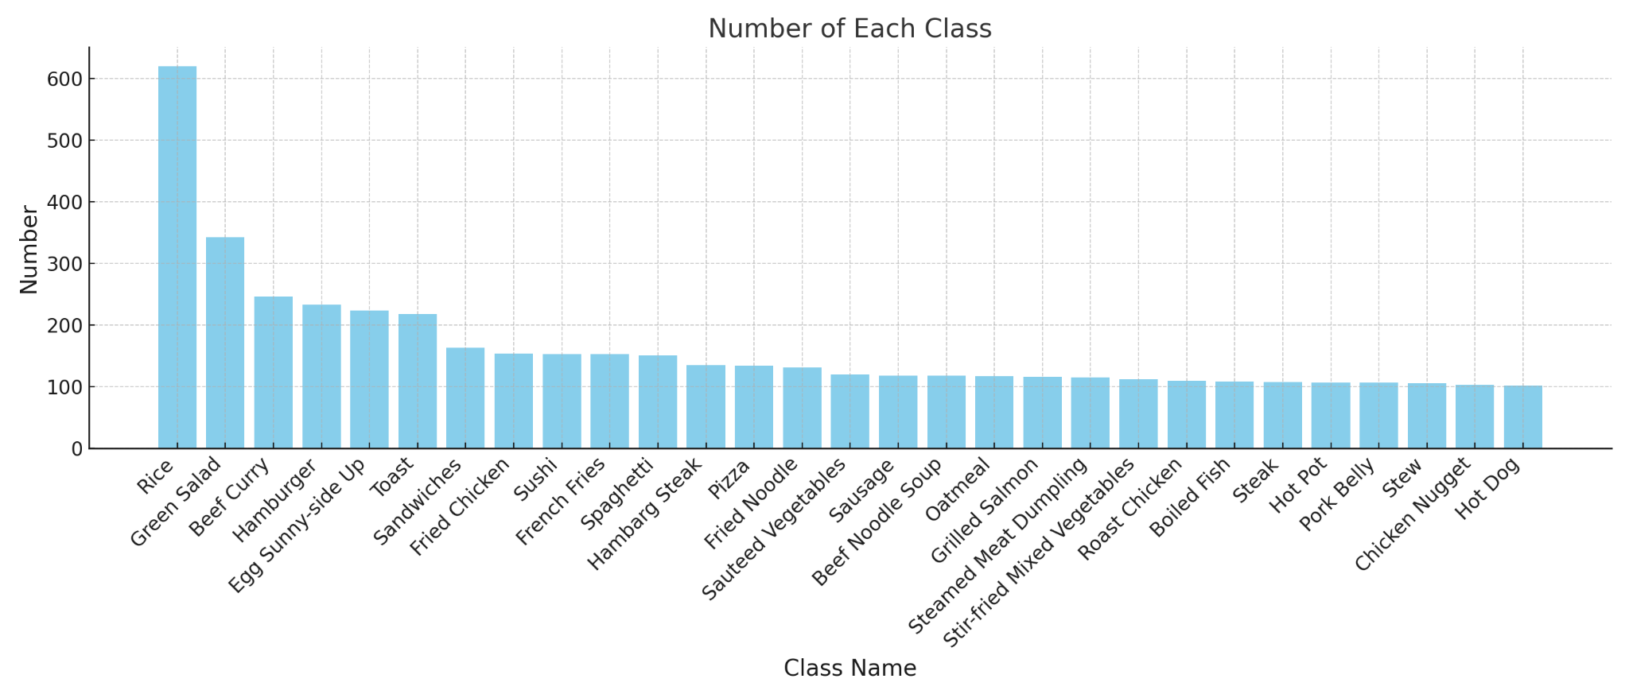

NutritionExpert
Members: Yi Hsuan Lee, Dustin Tsai, Sunny Chin, Ting-Yu Lin Mentor: Eric Young
Introduction
Methodology and Results
Discussion and Conclusions
By harnessing the power of AI technologies, we aim to democratize personalized nutrition, making it available to individuals of all backgrounds and lifestyles.
Meal Analysis: We selected YOLOv8 for training on the UECFOOD-256 and School Lunch datasets and integrated the CalorieNinjas API to provide the nutritional information of each detected food item.
Diet Planning: We leveraged the capabilities of GPT-4 through the OpenAI API to generate personalized diet plans.
YOLOv8 is a state-of-the-art object detection model that is known for its fast detection speed while maintaining high accuracy, making it suitable for detecting food items in real-time.
Our model’s backbone contains a series of convolutional layers that extract relevant features from the input image
Integration with Calorie Ninjas API, GPT-4, and Streamlit allows for efficient and user-friendly personalized nutrition analysis and diet planning.
Food Detection
Dataset and Data Preprocessing
The datasets used in our project are UECFOOD-256 and school lunch available at
http://foodcam.mobi/dataset.html
Food photos annotated with bounding boxes coordinates.
276 categories, predominantly Japanese cuisine, and 65 categories selected for training.
Data pre-processing:
Split each label into individual .txt file for YOLO format.
Perform data normalization and data cleaning through overwriting the existing file with the identical filename.
Data split: Train:Val = 9:1
Most food items could be accurately detected with accurate labels and bounding boxes (mAP ~73%).
Food items that were partially cut off on the edges of some images were frequently labeled incorrectly.
Different model settings and hyperparameters have been explored.
(UECFOOD256)
(10 epochs / 80% train - 10% val - 10% test / λ = 5e-4)
Future Work
Food images are annotated with bounding boxes coordinates.
29 food categories were selected from 256 categories of predominantly Japanese and Asian cuisine,
Processed bounding box information into individual .txt files (each corresponding to a food image) in YOLO format
Performed data cleaning and normalization
Dataset Split: Train: Val: Test = 8:1:1.
P-R Curve
Larger datasets
– Increase the number of categories and images
Handling balanced data
– Balance the number of images across different classes
Weight measurements
– Try methods to get volume and weights of food
Hyperparameters tuning
(20 epochs / 90% train - 10% val / λ = 0.03)
(UECFOOD256+school_lunch)

Slide 36
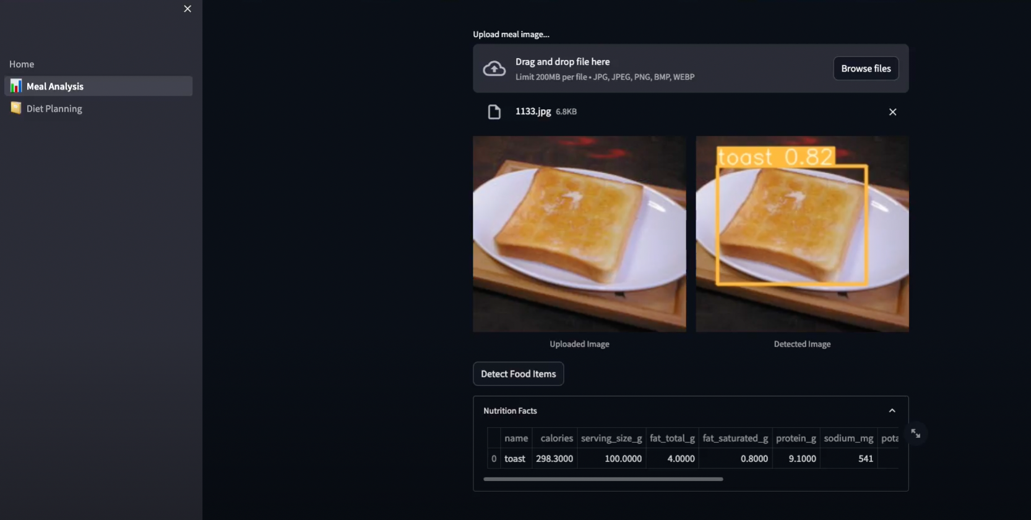
Meal Analysis

Slide 37
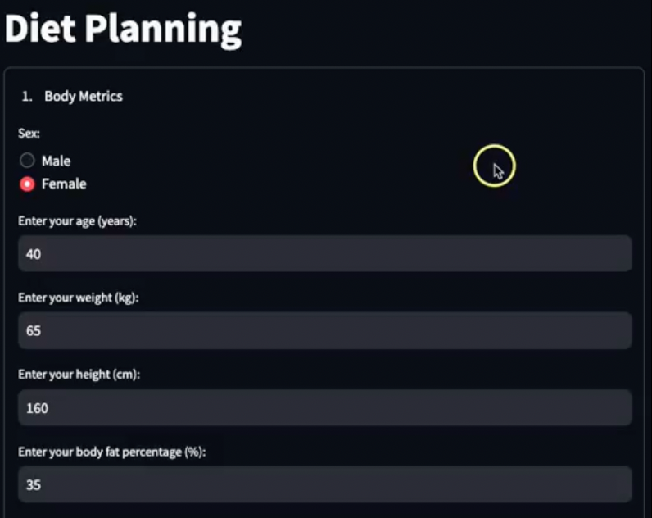
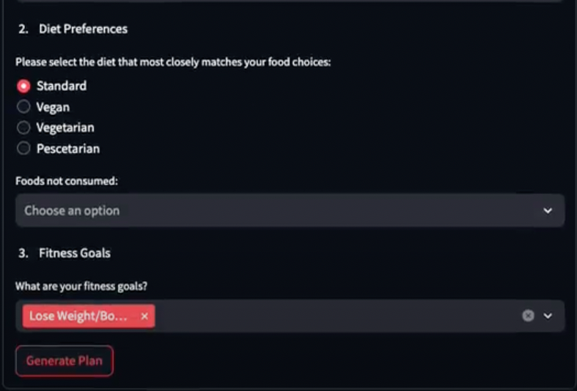
Diet Planning

Slide 38
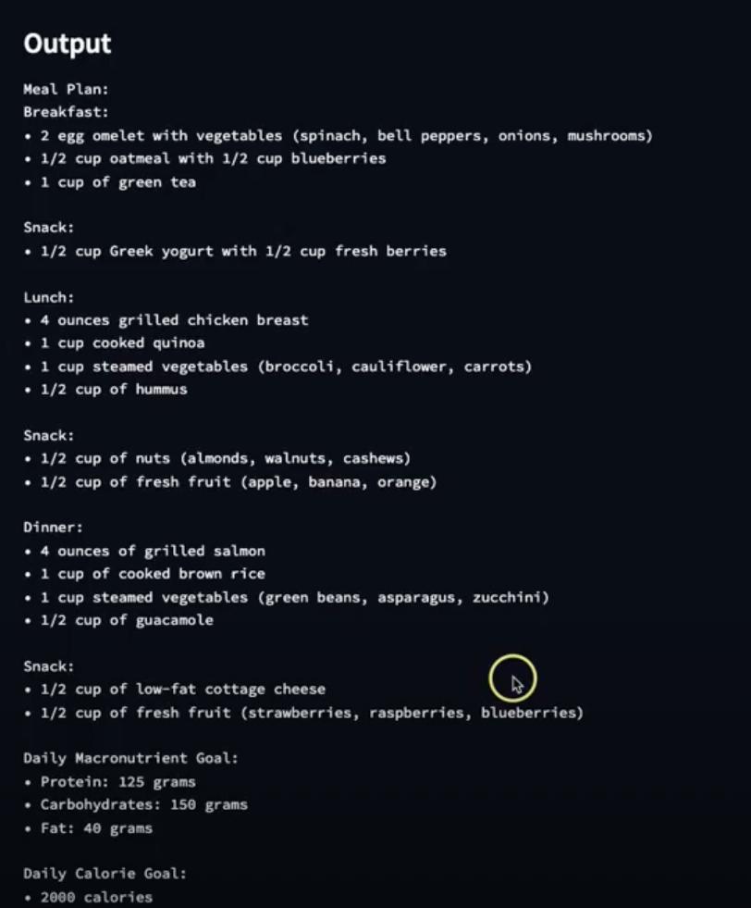
Diet Planning

Slide 39
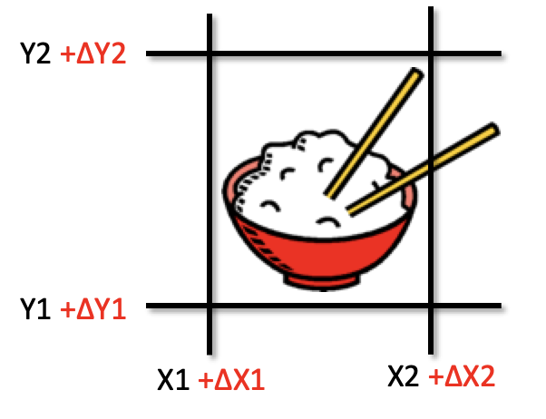

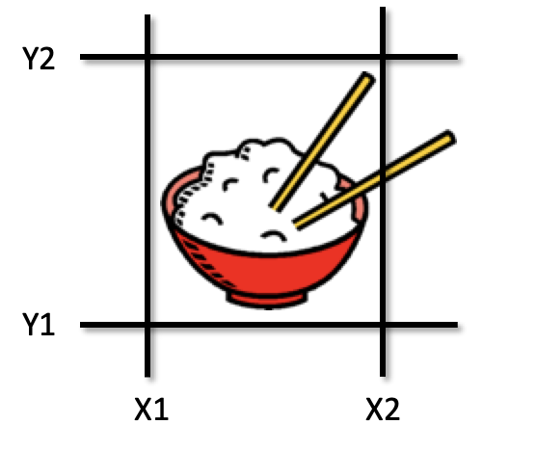
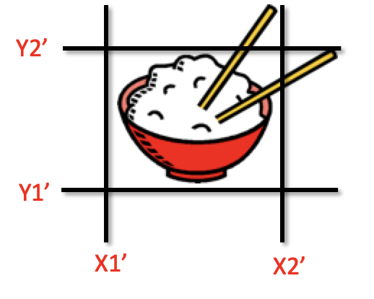
YOLOv8- Object detection models
Anchors Boxes |  | Object Detection Tasks
predict a bounding box through regression |  | Predicting a class label through classification
1.Original Image | 3. Predicted bounding box offsets | 1. Original Image | 3. Class Prediction
2. Grid of Cells and Anchor Boxes | 4. Applying Regression to Anchor Boxes | 2. Feature Extraction | 4. Class Label Assignment
Probability
Rice: 0.95
Noodles: 0.05
Feature Vectors
Final prediction:
Rice

